Slide 1
INTRODUCTION TO NEURAL NETWORKS
BY : AHMED YOUSRY

Slide 2
AGENDA
Biological Background
Artificial Neuron
Classes of Neural Networks
  Perceptrons
  Multi-Layered Feed-Forward Networks
  Recurrent Networks.
Modeling the neuron
Activation functions

Slide 3
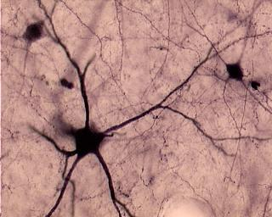
BIOLOGICAL BACKGROUND
Neuron consists of:
  Cell body
  Dendrites
  Axon
  Synapses
Neural activation :
  Throught dendrites/axon
  Synapses have different strengths

Slide 4
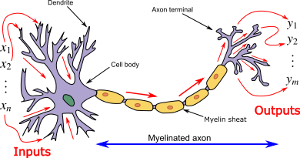
ANN INGREDIENTS

Slide 5
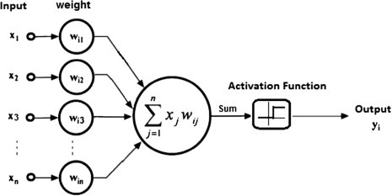

SIMULATION ON ANN

Slide 6

ARTIFICIAL NEURON EXAMPLE
Input links
(dendrites)
Unit
(cell body)
Output links
(axon)
aj
Wji
in_{i} =
Σa_{j}W_{ji}
a_{i} = g(in_{i})
a_{i}

Slide 7
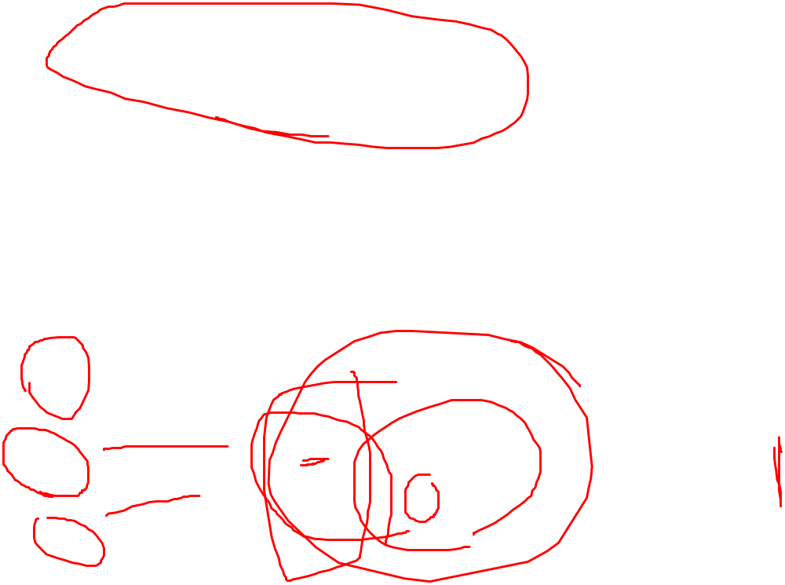
CLASS I: PERCEPTRON
I_{j}
W_{j}
O
-1
W₀
W₁
in =
Σa_{j}W_{j}
a = g(in)
a₁
a
W₂
a₂
{
0, in<0
a = g(-W₀ + W₁a₁ + W₂a₂)
g(in) =
1, in>0

Slide 8

CLASS II: MULTI-LAYER
FEED-FORWARD NETWORKS
Input
Hidden
Output
Multiple layers:
  hidden layer(s)
Feed-forward:
  Output links only connected to input links in the next layer
Complex non-linear functions can be represented

Slide 9
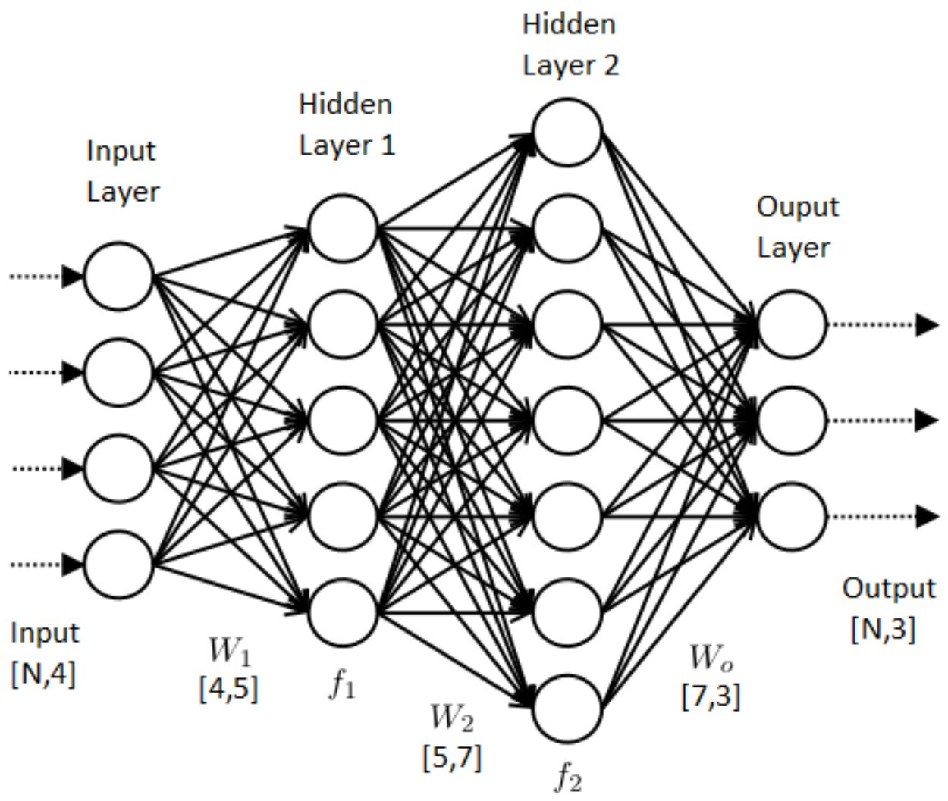
MULTI LAYER NN EXAMPLE

Slide 10

CLASS III: RECURRENT NETWORKS
No restrictions on connections
Behaviour more difficult to predict/ understand
Apps: Voice to text
Input
Hidden
Output

Slide 11
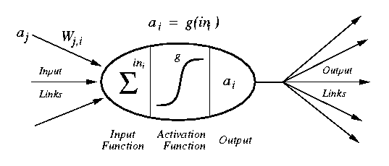

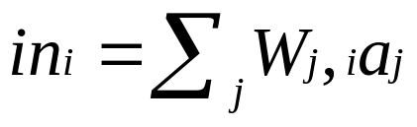
MODELLING A NEURON
a_{j} :Activation value of unit j
w_{j,I} :Weight on the link from unit j to unit i
in_{I} :Weighted sum of inputs to unit i
a_{I} :Activation value of unit i
g :Activation function

Slide 12
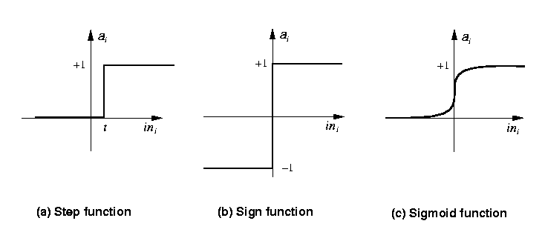
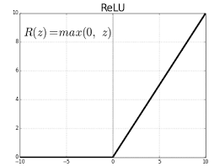
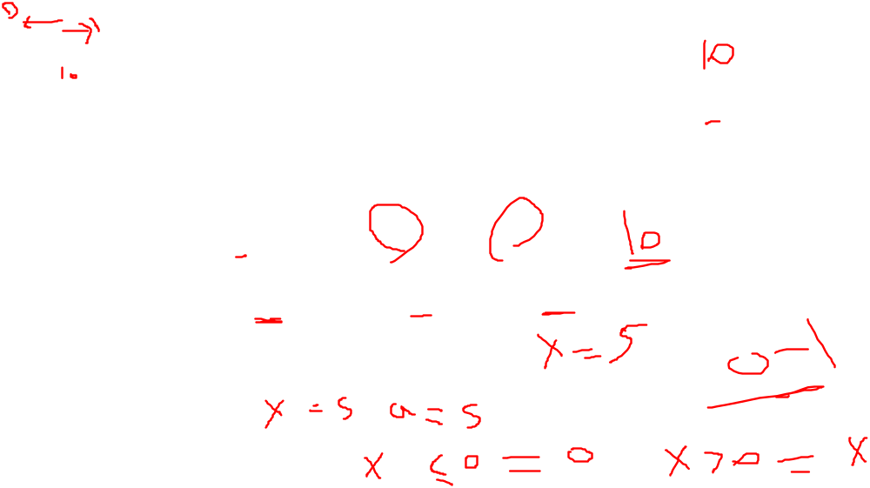
ACTIVATION FUNCTIONS
Step_{t}(x) = 1 if x >= t, else 0
Sign(x) = +1 if x >= 0, else –1
Sigmoid(x) = 1/(1+e^{-x})
Identity Function
Relu(x) = max(o,X)

Slide 13
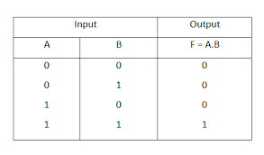
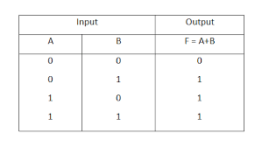
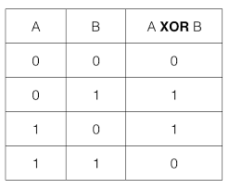
BOOLEAN FUNCTION

Slide 14
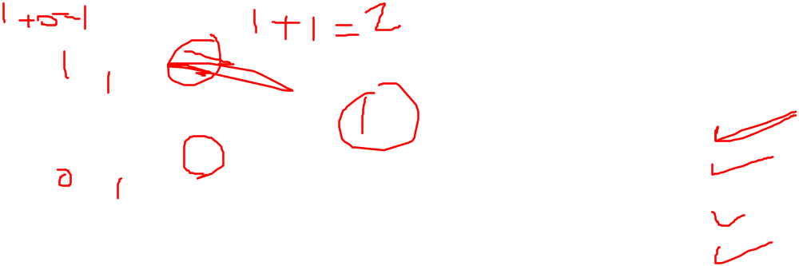

THE FIRST NEURAL NEURAL NETWORKS
X₁
1
Y
X₂
1
AND Function
Threshold(Y) = 2

Slide 15
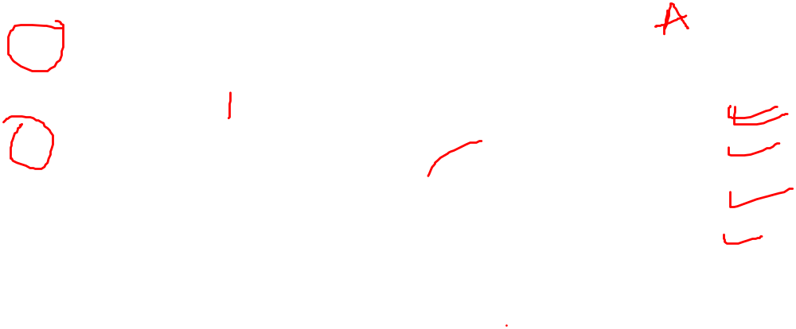

THE FIRST NEURAL NEURAL NETWORKS
X₁
2
Y
X₂
2
AND Function
OR Function
Threshold(Y) = 2

Slide 16
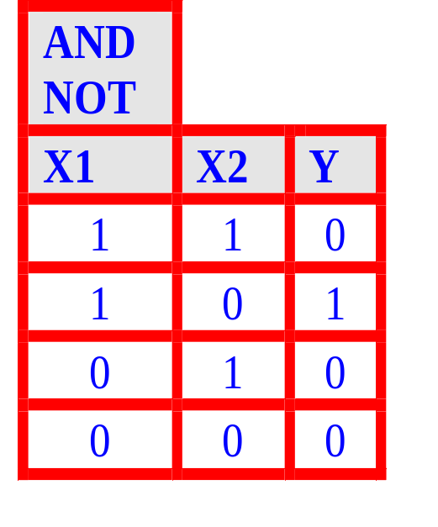
THE FIRST NEURAL NEURAL NETWORKS
X₁
2
Y
X₂
-1
AND NOT Function
Threshold(Y) = 2

Slide 17
What can perceptrons represent?
1,1
1,1
0,1
0,1
0,0
1,0
1,0
AND
0,0
XOR
Functions which can be separated in this way are called Linearly Separable
Only linearly Separable functions can be represented by a perceptron

Slide 18
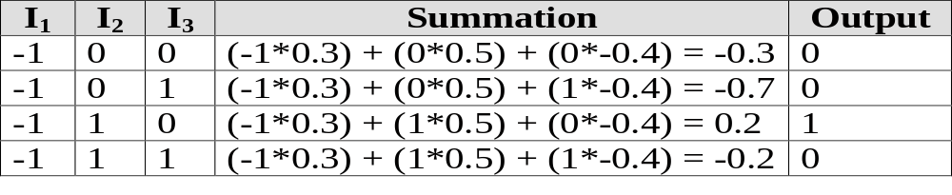
TRAINING A PERCEPTRONS
-1
W = 0.3
x
W = 0.5
t = 0.0
W = -0.4
y

Slide 19
LEARNING
While epoch produces an error
  Present network with next inputs from epoch
  Err = T – O
  If Err <> 0 then
    W_{j} = W_{j} + LR * I_{j} * Err
  End If
End While

Slide 20
LEARNING
While epoch produces an error
  Present network with next inputs from epoch
  Err = T – O
  If Err <> 0 then
    W_{j} = W_{j} + LR * I_{j} * Err
  End If
End While
Epoch : Presentation of the entire training set to the neural network.
In the case of the AND function an epoch consists of four sets of inputs being presented to the network (i.e. [0,0], [0,1], [1,0], [1,1])

Slide 21
LEARNING
While epoch produces an error
  Present network with next inputs from epoch
  Err = T – O
  If Err <> 0 then
    W_{j} = W_{j} + LR * I_{j} * Err
  End If
End While
Training Value, T : When we are training a network we not only present it with the input but also with a value that we require the network to produce. For example, if we present the network with [1,1] for the AND function the training value will be 1

Slide 22
LEARNING
While epoch produces an error
  Present network with next inputs from epoch
  Err = T – O
  If Err <> 0 then
    W_{j} = W_{j} + LR * I_{j} * Err
  End If
End While
Error, Err : The error value is the amount by which the value output by the network differs from the training value. For example, if we required the network to output 0 and it output a 1, then Err = -1

Slide 23
LEARNING
While epoch produces an error
  Present network with next inputs from epoch
  Err = T – O
  If Err <> 0 then
    W_{j} = W_{j} + LR * I_{j} * Err
  End If
End While
Output from Neuron, O : The output value from the neuron
Ij : Inputs being presented to the neuron
Wj : Weight from input neuron (I_{j}) to the output neuron
LR : The learning rate. This dictates how quickly the network converges. It is set by a matter of experimentation. It is typically 0.1

